Slide 1
AI On Your Phone
@ray_deck
github.com/rhdeck/boscc29

Slide 2
What’s it Good For?

Slide 3
Identification

Slide 4
Generation

Slide 5
Voice

Slide 6
Prediction

Slide 7
Prediction

Slide 8
Artificial Intelligence Deep Learning Machine Learning Statistical Computing

Slide 9
Supervised Learning Unsupervised Learning Reinforcement Learning

Slide 10
ML is About Ops and Numbers
Input Shape
“The Graph”
Conv2D, ReLU, MaxPool, etc…
Output Shape

Slide 11
y = mx + b

Slide 12
Ops
Convolutions
Pooling
ReLU
TanH
Sigmoid
LSTM
GRU
Dense/Fully-Connected
More…

Slide 13
High-Dimensional Numbers

Slide 14
Images are High-Dimensional Numbers!

Slide 15
Considerations for Deployment
Low(er) power target
Detached from training context
Consumed by non-data-scientists

Slide 16
Packaging

Slide 17
Models (Can Be) Files
Shapes of Input(s)
Operations
Hyperparameters
Weights
Sources & Drains
Shapes of Output(s)

Slide 18
Faster, Smaller
Quantization
Optimization
Planning

Slide 19
Pruning

Slide 20
Planning
VGG16 550MB
InceptionV3 94MB
MobileNet 17MB

Slide 21
What Do we Need in the File?
Convert Image/Frame to Normalized Number
Run the model efficiently on local resources
Convert output number to what we seek:
Dictionaries of labels
Generated Image
Prediction
etc

Slide 22
Lite

Slide 23
ML Universe
Cloud
Azure, Amazon, Google, MachineBox…
…plus MacGyver, Algorithmia…
Train
Inference
Tensorflow, Theano, CNTK…
…CoreML, TF Lite, TF Mobile, TF.JS Caffe Lite
Local

Slide 24
iOS Runtime and Bindings
File Format
Conversion Tooling

Slide 25
Runtime and Bindings
CVPixelBuffer in, Dictionary Out
Support for OTA/Runtime Download and Compilation
Uses Metal Shaders for processing
Limited Operation Support

Slide 26
Run!
MLModel.compile(file)
VNCoreMLRequest(model:model…)
VNImageRequestHandler
h.perform([r])

Slide 27
.mlmodel
Protobuf
Feature Normalization
Value Range of Numbers (0-255 -> 0-1)
Mean Value
Channel Ordering
BGR vs RGB
Output Labeling/Denormalization

Slide 28
Conversion
Keras – coremlconverter
Tensorflow – tf-coreml
CNTK - mmdnn
MXNet – mxnet-to-coreml

Slide 29
Advantages
Ease of Application
Speed Multiple analyses per second
Separation of Concerns Compilation vs Inference
Source Agnostic

Slide 30
Multiple Runtimes
File Format
Converter
Lite

Slide 31
Cross-Platform
iOS, Android, Raspberry Pi
feed() and run()
No Compilation Step
Number-to-Number
Lite

Slide 32
.tflite
FlatBuf
Quicker Memory Access
Smaller – less overhead
Alternative Precision: Bfloat16
Lite

Slide 33
Conversion
toco Tensorflow Optimizing Converter
Lite

Slide 34
iOS Only | Multiplatform
Input/Output Affordance | Just the Numbers
Production | Beta
Inference Only | Training?

Slide 35
A Look to the Future – and Past!

Slide 37
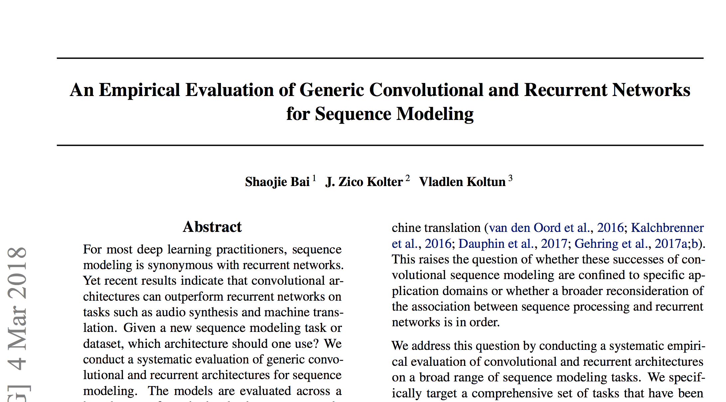
Old Stuff Works
https://arxiv.org/pdf/1803.01271.pdf

Slide 38
@ray_deck
github.com/rhdeck/boscc29

